Slide 1

KYUNGSUNG UNIVERSITY
웹프로그래밍 응용
고민 상담 BAR Nightcap
React & Tomcat(Springboot)
2019875058 정재훈
2021863026 류연우
웹프로그래밍 응용
김주현 교수님

Slide 2

Tomcat ??

Slide 3

Spring boot ??

Slide 4
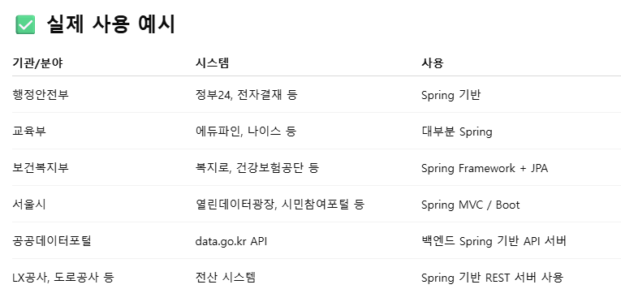

Slide 5
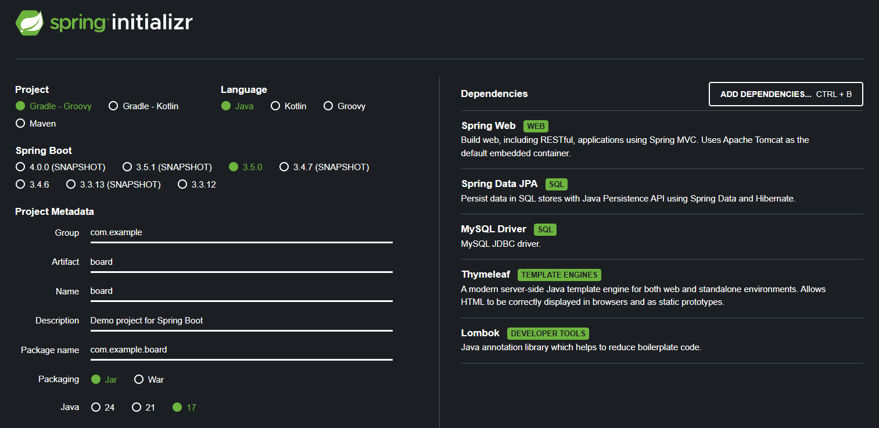

Slide 6
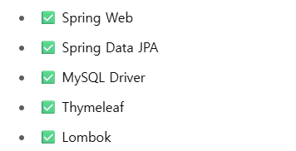

Slide 7
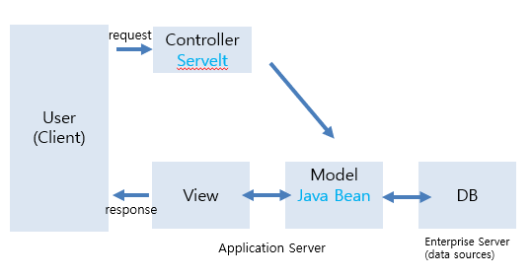
MVC
(React)

Slide 8
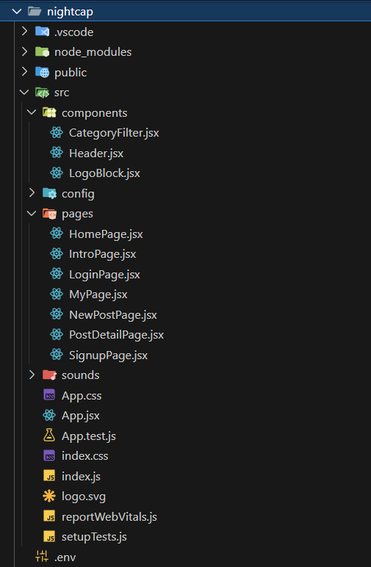
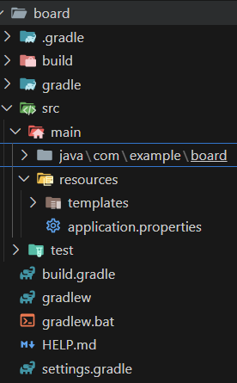
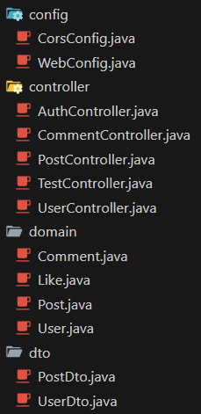
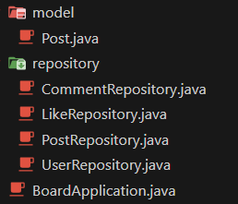
디렉토리 구조

Slide 9
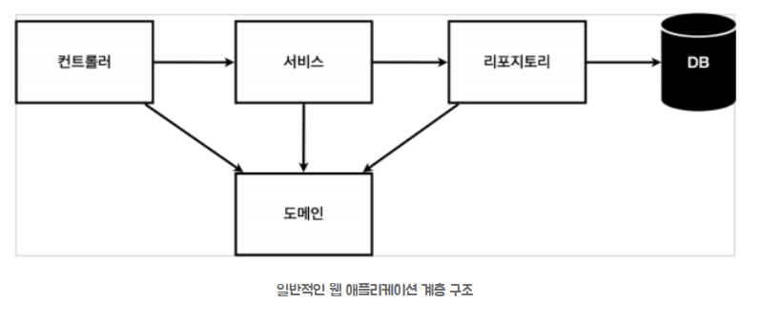
Spring-boot 흐름 구조

Slide 10
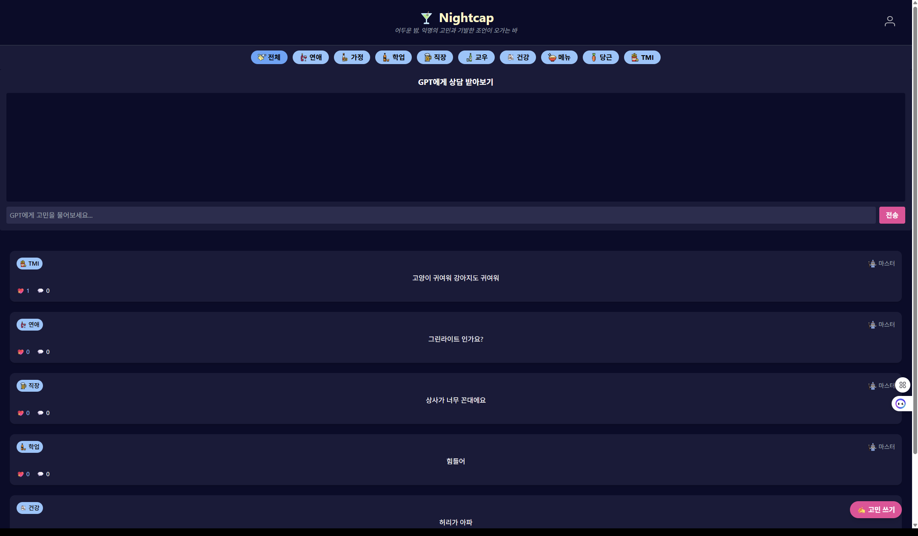

Slide 11
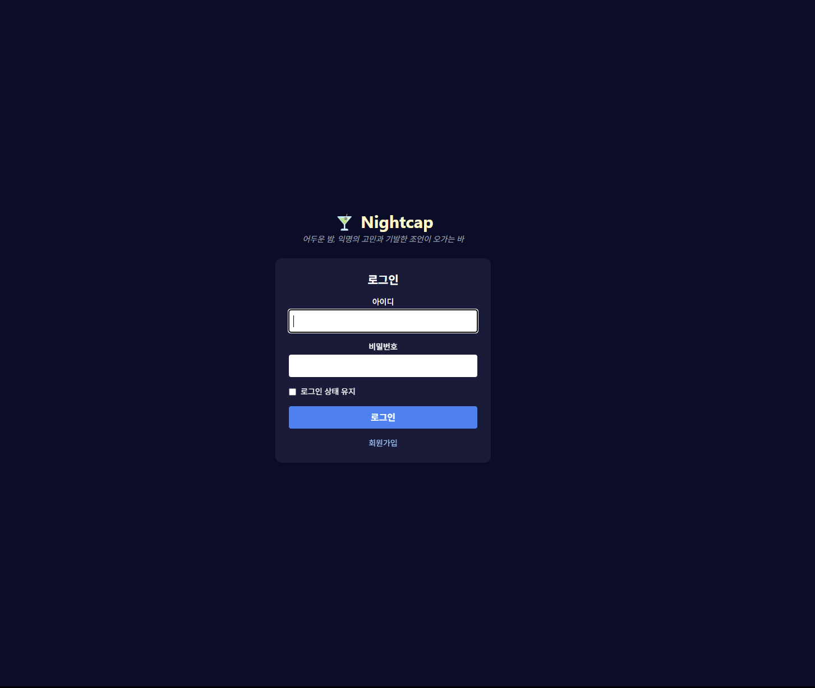

Slide 12
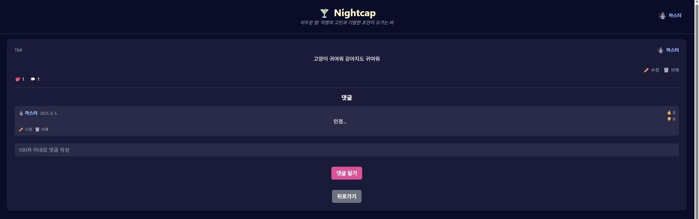

Slide 13
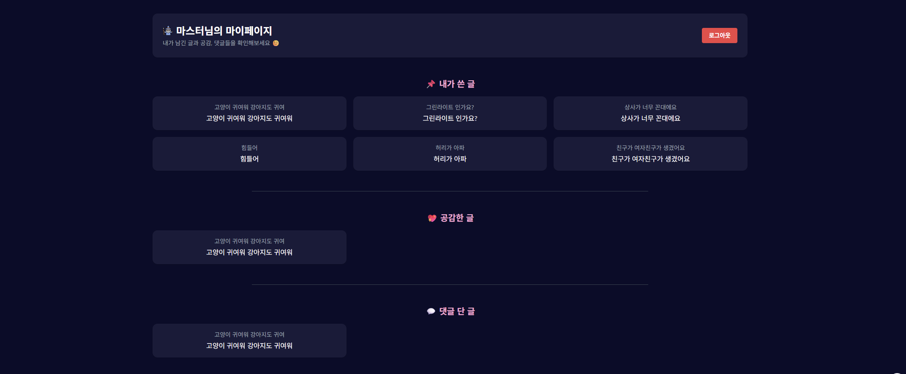

Slide 14
application.properties
spring.datasource.url=jdbc:mysql://localhost:3306/board?serverTimezone=UTC
spring.datasource.username=root
spring.datasource.password=
spring.jpa.hibernate.ddl-auto=update
spring.jpa.show-sql=true
spring.jpa.properties.hibernate.dialect=org.hibernate.dialect.MySQL8Dialect
logging.level.org.hibernate.orm.jdbc.bind=trace
logging.level.org.springframework.orm.jpa=debug
logging.level.org.hibernate=debug
logging.level.org.springframework.web=DEBUG
logging.level.org.hibernate.SQL=DEBUG
logging.level.org.hibernate.type.descriptor.sql=TRACE

Slide 15
Header.jsx
return (
<div className="bg-[#0b0c2a] text-white border-b border-gray-700">
<div className="relative pt-6 px-4">
<div className="absolute right-10 top-10 flex items-center gap-2">
{currentUser ? (
<>
<img
src={
aliasIcons[getAliasBase(currentUser.alias)] ||
"/icons/default.png"
}
alt="alias"
className="w-6 h-6"
/>
<span
className="text-sm text-blue-300 font-semibold cursor-pointer"
onClick={() => navigate("/mypage")}
>
{currentUser.alias}
</span>
</>
) : (
<button onClick={() => navigate("/login")}>
<img src="/icons/person.png" alt="로그인" className="w-6 h-6" />
</button>
)}
</div>
<div className="flex justify-center">
<LogoBlock resetCategory={() => setSelectedCategory("전체")} />
</div>
</div>
</div>
);
}

Slide 16
LogoBlock.jsx
import { useNavigate } from "react-router-dom";
export default function LogoBlock({ resetCategory }) {
const navigate = useNavigate();
const handleClick = () => {
if (resetCategory) resetCategory();
navigate("/home");
};
return (
<div
onClick={handleClick}
className="text-center cursor-pointer mb-6"
>
<h1 className="text-3xl font-bold text-yellow-100 flex justify-center items-center gap-2">
🍸 Nightcap
</h1>
<p className="text-sm italic text-gray-400 mt-1">
어두운 밤, 익명의 고민과 기발한 조언이 오가는 바
</p>
</div>
);
}

Slide 17
CategoryFilter.jsx
import { useLocation } from "react-router-dom";
export default function CategoryFilter({ selectedCategory, setSelectedCategory }) {
const location = useLocation();
const hiddenRoutes = ["/", "/mypage"];
if (hiddenRoutes.includes(location.pathname)) return null;
const categoryIcons = {
전체: "all",
연애: "love",
가정: "family",
학업: "study",
직장: "work",
교우: "friends",
건강: "health",
메뉴: "menu",
당근: "carrot",
TMI: "tmi",
};
const allCategories = Object.keys(categoryIcons);

Slide 18
CategoryFilter.jsx
return (
<div className="flex flex-wrap gap-3 justify-center bg-[#1a1b3a] py-3 px-4">
{allCategories.map((cat, i) => (
<button
key={i}
onClick={() => setSelectedCategory(cat)}
className={`flex items-center gap-1 px-4 py-1 rounded-full font-bold transition ${
selectedCategory === cat
? "bg-blue-400 text-black"
: "bg-blue-300 text-black hover:bg-blue-400"
}`}
>
<img
src={`/icons/${categoryIcons[cat]}.png`}
alt={cat}
className="w-5 h-5"
/>
{cat}
</button>
))}
</div>
);
}

Slide 19
Intro.jsx
import { useNavigate } from "react-router-dom";
import LogoBlock from "../components/LogoBlock";
export default function IntroPage() {
const navigate = useNavigate();
return (
<div className="min-h-screen bg-[#0b0c2a] flex flex-col items-center justify-center text-white text-center px-4">
<LogoBlock />
<p className="text-lg mt-4 mb-8 text-gray-300">
익명의 고민과 따뜻한 조언이 오가는 밤의 바에 오신 것을 환영합니다.
</p>
<button
onClick={() => navigate("/home")}
className="bg-pink-500 hover:bg-pink-600 px-6 py-3 rounded-full text-lg font-bold transition"
>
🍷 입장하기
</button>
</div>
);
}

Slide 20
App.jsx
import { Routes, Route, useLocation } from "react-router-dom";
import { useEffect, useState } from "react";
import HomePage from "./pages/HomePage";
import LoginPage from "./pages/LoginPage";
import PostDetailPage from "./pages/PostDetailPage";
import NewPostPage from "./pages/NewPostPage";
import SignupPage from "./pages/SignupPage";
import Header from "./components/Header";
import MyPage from "./pages/MyPage";
import "./App.css";
import CategoryFilter from "./components/CategoryFilter";
import IntroPage from "./pages/IntroPage";
export default function App() {
const location = useLocation();
const hideHeaderRoutes = ["/", "/login", "/signup", "/mypage"];
const shouldHideHeader = hideHeaderRoutes.includes(location.pathname);
const [posts, setPosts] = useState([]);
const [isLoggedIn, setIsLoggedIn] = useState(false);
const [authToken, setAuthToken] = useState(null);
const [userId, setUserId] = useState(null);
const [selectedCategory, setSelectedCategory] = useState("전체");
const [currentUser, setCurrentUser] = useState(null);

Slide 21
App.jsx
useEffect(() => {
fetch("http://localhost:8080/posts")
.then((res) => res.json())
.then((data) => {
console.log("서버에서 받아온 posts:", data);
setPosts(data);
});
}, []);
useEffect(() => {
const savedUser = localStorage.getItem("user");
const loginTime = localStorage.getItem("loginTime");
const SESSION_DURATION = 1000 * 60 * 60; // 1시간
if (savedUser && loginTime) {
const now = Date.now();
const elapsed = now - parseInt(loginTime, 10);
if (elapsed < SESSION_DURATION) {
const parsed = JSON.parse(savedUser);
setIsLoggedIn(true);
setCurrentUser(parsed);
setUserId(parsed.id);
} else {
// ⏱ 세션 만료
localStorage.removeItem("user");
localStorage.removeItem("loginTime");
setIsLoggedIn(false);
setCurrentUser(null);
setUserId(null);
alert("세션이 만료되어 자동 로그아웃 되었습니다.");
}
}
}, []);
useEffect(() => {
const saved =
JSON.parse(localStorage.getItem("user")) ||
JSON.parse(sessionStorage.getItem("user"));
if (saved) {
setIsLoggedIn(true);
setCurrentUser(saved);
setUserId(saved.id);
}
}, []);

Slide 22
App.jsx
return (
<div className="App">
{!shouldHideHeader && (
<Header
currentUser={currentUser}
selectedCategory={selectedCategory}
setSelectedCategory={setSelectedCategory}
/>
)}
{!["/new", "/signup", "/login"].includes(location.pathname) &&
!location.pathname.startsWith("/posts") && (
<CategoryFilter
selectedCategory={selectedCategory}
setSelectedCategory={setSelectedCategory}
/>
)}
<Routes>
<Route path="/" element={<IntroPage />} />
<Route
path="/home"
element={
<HomePage
posts={posts}
setPosts={setPosts}
isLoggedIn={isLoggedIn}
currentUser={currentUser}
selectedCategory={selectedCategory}
/>
}
/>
<Route
path="/login"
element={
<LoginPage
setIsLoggedIn={setIsLoggedIn}
setUserId={setUserId}
setCurrentUser={setCurrentUser}
/>
}
/>
<Route path="/signup" element={<SignupPage />} />
<Route
path="/posts/:postId"
element={
<PostDetailPage
posts={posts}
setPosts={setPosts}
isLoggedIn={isLoggedIn}
authToken={authToken}
userId={userId}
currentUser={currentUser}
/>
}
/>
<Route
path="/new"
element={
<NewPostPage
setPosts={setPosts}
isLoggedIn={isLoggedIn}
userId={userId}
currentUser={currentUser}
/>
}
/>
<Route
path="/mypage"
element={<MyPage currentUser={currentUser} isLoggedIn={isLoggedIn} />}
/>
</Routes>
</div>
);
}

Slide 23
Header.jsx
import { useNavigate } from "react-router-dom";
import LogoBlock from "./LogoBlock";
export default function Header({
setSelectedCategory,
currentUser,
}) {
const navigate = useNavigate();
const aliasIcons = {
밤손님: "/icons/night.png",
마스터: "/icons/wizard.png",
요정: "/icons/fairy.png",
바텐더: "/icons/bartender.png",
해결사: "/icons/detective.png",
};
const getAliasBase = (alias) => alias?.match(/^[^\d]+/)[0];

Slide 24
Homepage.jsx
import { useState, useEffect } from "react";
import { useNavigate, useLocation } from "react-router-dom";
export default function HomePage({ posts, setPosts, isLoggedIn, currentUser, selectedCategory }) {
const navigate = useNavigate();
const location = useLocation();
const [chatLog, setChatLog] = useState([]);
const [input, setInput] = useState("");
const [loading, setLoading] = useState(false);
const [likedPosts, setLikedPosts] = useState({});
const categoryIcons = {
연애: "love",
가정: "family",
학업: "study",
직장: "work",
교우: "friends",
건강: "health",
메뉴: "menu",
당근: "carrot",
TMI: "tmi",
};
useEffect(() => {
const fetchPosts = async () => {
try {
const res = await fetch("http://localhost:8080/posts");
if (!res.ok) return;
const data = await res.json();
setPosts(Array.isArray(data) ? data : []);
} catch {}
};
fetchPosts();
}, [location.pathname]);
const handleGPTSend = async () => {
if (!input.trim() || loading) return;
setLoading(true);
const userMessage = { role: "user", content: input };
const newChatLog = [...chatLog, userMessage];
try {
const res = await fetch("https://api.openai.com/v1/chat/completions", {
method: "POST",
headers: {
"Content-Type": "application/json",
Authorization: `Bearer ${process.env.REACT_APP_OPENAI_API_KEY}`,
},
body: JSON.stringify({
model: "gpt-3.5-turbo",
messages: newChatLog,
}),
});
const data = await res.json();
const botMessage = data.choices?.[0]?.message;
setChatLog([...newChatLog, botMessage]);
} catch {}
setInput("");
setLoading(false);
};

Slide 25
Homepage.jsx
const handleTogglePostLike = async (postId) => {
if (!isLoggedIn || !currentUser?.id) return;
try {
const res = await fetch(
`http://localhost:8080/posts/${postId}/like?userId=${currentUser.id}`,
{
method: "PUT",
credentials: "include",
}
);
const result = await res.text();
setPosts((prev) =>
prev.map((p) =>
p.id === postId
? {
...p,
likes: result === "liked" ? (p.likes || 0) + 1 : Math.max((p.likes || 1) - 1, 0),
}
: p
)
);
setLikedPosts((prev) => ({
...prev,
[postId]: result === "liked",
}));
} catch {}
};
const filteredPosts = Array.isArray(posts)
? selectedCategory === "전체"
? posts
: posts.filter((post) => post.category === selectedCategory)
: [];

Slide 26
Homepage.jsx
return (
<div className="bg-[#0b0c2a] min-h-screen text-white">
<button
onClick={() => {
if (!isLoggedIn) {
window.location.href = "/login";
return;
}
navigate("/new");
}}
className="fixed bottom-6 right-6 bg-pink-500 hover:bg-pink-600 text-white font-bold py-2 px-4 rounded-full shadow-lg transition"
>
✍️ 고민 쓰기
</button>
<div className="bg-[#1a1b3a] p-4 rounded-md mb-6">
<h3 className="text-lg font-bold mb-3">GPT에게 상담 받아보기</h3>
<div className="h-64 overflow-y-auto bg-[#0b0c2a] p-3 rounded mb-3 space-y-2">
{chatLog.map((msg, i) => (
<div key={i} className={`flex ${msg.role === "user" ? "justify-end" : "justify-start"}`}>
<div
className={`max-w-[80%] p-3 rounded-lg text-sm ${msg.role === "user"
? "bg-pink-500 text-white rounded-br-none"
: "bg-gray-700 text-white rounded-bl-none"
}`}
>
<strong className="block mb-1">{msg.role === "user" ? "나" : "GPT"}</strong>
<p className="whitespace-pre-wrap">{msg.content}</p>
</div>
</div>
))}
</div>
<div className="flex gap-2">
<input
type="text"
value={input}
onChange={(e) => setInput(e.target.value)}
className="flex-grow p-2 rounded bg-[#2c2d4f] text-white"
placeholder="GPT에게 고민을 물어보세요..."
/>
<button
onClick={handleGPTSend}
className="bg-pink-500 hover:bg-pink-600 px-4 py-2 rounded font-bold"
>
전송
</button>
</div>
</div>

Slide 27
Homepage.jsx
<div className="px-6 pt-6 space-y-6">
{filteredPosts.length === 0 ? (
<div className="text-center py-10 text-gray-400">
아직 게시물이 없습니다. 첫 게시물을 작성해보세요!
</div>
) : (
filteredPosts.map((post) => (
<div
key={post.id}
className="bg-[#1a1b3a] p-4 rounded-xl shadow-md cursor-pointer"
onClick={() => navigate(`/posts/${post.id}`)}
>
<div className="flex justify-between items-center text-sm text-gray-400">
<div className="flex items-center gap-1 bg-blue-300 px-2 py-1 rounded-full text-sm text-black font-medium">
<img
src={`/icons/${categoryIcons[post.category] ?? "default"}.png`}
className="w-4 h-4"
alt="category"
/>
<span>{post.category}</span>
</div>
<div className="flex items-center gap-1">
<img
src={post.profileIcon || "/icons/default.png"}
className="w-5 h-5"
alt="icon"
/>

Slide 28
Homepage.jsx
<span>{post.author || post.authorAlias || "익명"}</span>
</div>
</div>
<div className="text-base my-2">{post.content}</div>
<div className="flex gap-4 text-sm items-center">
<button
className={
likedPosts[post.id]
? "text-pink-400"
: "text-blue-300 hover:text-blue-400"
}
onClick={(e) => {
e.stopPropagation();
handleTogglePostLike(post.id);
}}
>
💖 {post.likes ?? 0}
</button>
<span>
💬 {Array.isArray(post.comments) ? post.comments.length : 0}
</span>
</div>
</div>
))
)}
</div>
</div>
);
}

Slide 29
LogoBlock.jsx
import { useNavigate } from "react-router-dom";
export default function LogoBlock({ resetCategory }) {
const navigate = useNavigate();
const handleClick = () => {
if (resetCategory) resetCategory();
navigate("/home");
};
return (
<div
onClick={handleClick}
className="text-center cursor-pointer mb-6"
>
<h1 className="text-3xl font-bold text-yellow-100 flex justify-center items-center gap-2">
🍸 Nightcap
</h1>
<p className="text-sm italic text-gray-400 mt-1">
어두운 밤, 익명의 고민과 기발한 조언이 오가는 바
</p>
</div>
);
}

Slide 30
LoginPage.jsx
import { useState, useEffect, useRef } from "react";
import LogoBlock from "../components/LogoBlock";
import { useNavigate } from "react-router-dom";
export default function LoginPage({
setIsLoggedIn,
setUserId,
setCurrentUser,
}) {
const [username, setUsername] = useState("");
const [password, setPassword] = useState("");
const [errorMsg, setErrorMsg] = useState("");
const [loginSuccessMsg, setLoginSuccessMsg] = useState("");
const [keepLoggedIn, setKeepLoggedIn] = useState(false);
const navigate = useNavigate();
const usernameRef = useRef(null);
useEffect(() => {
usernameRef.current?.focus();
}, []);

Slide 31
LoginPage.jsx
const handleLogin = async (e) => {
e.preventDefault();
setErrorMsg("");
try {
const res = await fetch("http://localhost:8080/login", {
method: "POST",
headers: { "Content-Type": "application/json" },
body: JSON.stringify({ username, password }),
});
if (!res.ok) {
setErrorMsg("아이디 또는 비밀번호가 틀렸습니다.");
return;
}
const user = await res.json();
setCurrentUser(user);
setIsLoggedIn(true);
setUserId(user.id);
setLoginSuccessMsg("로그인 완료!");
const storage = keepLoggedIn ? localStorage : sessionStorage;
storage.setItem("user", JSON.stringify(user));
storage.setItem("loginTime", Date.now());
setTimeout(() => {
setLoginSuccessMsg("");
navigate("/home");
}, 1000);
} catch (error) {
setErrorMsg("서버와 통신 중 오류가 발생했습니다.");
}
};

Slide 32
LoginPage.jsx
return (
<div className="min-h-screen bg-[#0b0c2a] text-white flex flex-col items-center justify-center px-4">
{loginSuccessMsg && (
<div className="fixed top-4 right-4 bg-green-500 text-white px-4 py-2 rounded shadow-lg z-50 transition">
{loginSuccessMsg}
</div>
)}
<LogoBlock />
<div className="bg-[#1a1b3a] p-6 rounded-xl w-full max-w-sm space-y-4 shadow-lg">
<h2 className="text-xl font-semibold text-center">로그인</h2>
<form className="space-y-4" onSubmit={handleLogin}>
<div>
<label className="block mb-1 text-sm font-medium">아이디</label>
<input
ref={usernameRef}
type="text"
className="w-full p-2 rounded bg-white text-black"
required
value={username}
onChange={(e) => {
const onlyEnglish = e.target.value.replace(/[^a-zA-Z0-9]/g, "");
setUsername(onlyEnglish);
}}
/>
</div>

Slide 33
LoginPage.jsx
<div>
<label className="block mb-1 text-sm font-medium">비밀번호</label>
<input
type="password"
className="w-full p-2 rounded bg-white text-black"
required
value={password}
onChange={(e) => {
const noKorean = e.target.value.replace(/[ㄱ-ㅎㅏ-ㅣ가-힣]/g, "");
setPassword(noKorean);
}}
/>
</div>
<div className="flex items-center gap-2 text-sm text-white">
<input
type="checkbox"
id="keepLoggedIn"
checked={keepLoggedIn}
onChange={() => setKeepLoggedIn(!keepLoggedIn)}
/>
<label htmlFor="keepLoggedIn">로그인 상태 유지</label>
</div>

Slide 34
LoginPage.jsx
<button
type="submit"
className="w-full bg-blue-500 hover:bg-blue-400 text-white font-bold py-2 rounded"
>
로그인
</button>
{errorMsg && <p className="text-red-400 text-center">{errorMsg}</p>}
</form>
<button
className="mt-4 w-full text-sm text-blue-300 hover:underline"
onClick={() => navigate("/signup")}
>
회원가입
</button>
</div>
</div>
);
}

Slide 35
MyPage.jsx
import { useEffect, useState } from "react";
import { useNavigate } from "react-router-dom";
export default function MyPage({ currentUser, isLoggedIn }) {
const [myPosts, setMyPosts] = useState([]);
const [likedPosts, setLikedPosts] = useState([]);
const [commentedPosts, setCommentedPosts] = useState([]);
const navigate = useNavigate();
const getAliasBase = (alias) => {
return alias?.match(/^[^\d]+/)?.[0] || "기본";
};
const aliasIcons = {
밤손님: "/icons/night.png",
마스터: "/icons/wizard.png",
요정: "/icons/fairy.png",
바텐더: "/icons/bartender.png",
해결사: "/icons/detective.png",
};

Slide 36
MyPage.jsx
useEffect(() => {
if (!isLoggedIn || !currentUser?.id) return;
fetch(`http://localhost:8080/users/${currentUser.id}/posts`)
.then((res) => res.json())
.then((data) => setMyPosts(Array.isArray(data) ? data : []));
fetch(`http://localhost:8080/users/${currentUser.id}/liked-posts`)
.then((res) => res.json())
.then((data) => setLikedPosts(Array.isArray(data) ? data : []));
fetch(`http://localhost:8080/users/${currentUser.id}/commented-posts`)
.then((res) => res.json())
.then((data) => setCommentedPosts(Array.isArray(data) ? data : []));
}, [currentUser, isLoggedIn]);

Slide 37
MyPage.jsx
const Section = ({ title, posts, emptyMessage }) => (
<section className="space-y-4">
<h2 className="text-xl font-bold text-pink-300">{title}</h2>
{posts.length === 0 ? (
<p className="text-gray-400">{emptyMessage}</p>
) : (
<div className="grid gap-4 sm:grid-cols-2 md:grid-cols-3">
{posts.map((post) => (
<div
key={post.id}
onClick={() => navigate(`/posts/${post.id}`)}
className="cursor-pointer bg-[#1a1b3a] p-4 rounded-xl shadow hover:shadow-lg hover:bg-[#25274a] transition"
>
<div className="text-sm text-gray-400 mb-1">{post.title}</div>
<div className="text-white">{post.content}</div>
</div>
))}
</div>
)}
</section>
);

Slide 38
MyPage.jsx
return (
<div className="min-h-screen bg-[#0b0c2a] text-white px-6 py-10">
<div className="w-2/3 mx-auto space-y-12">
<div className="bg-[#1a1b3a] p-6 rounded-xl shadow flex justify-between items-center">
<div>
<h1 className="text-2xl font-bold text-white flex items-center gap-2">
<img
src={
aliasIcons[getAliasBase(currentUser?.alias)] ||
"/icons/default.png"
}
alt="icon"
className="w-6 h-6"
/>
{currentUser?.alias || "사용자"}님의 마이페이지
</h1>
<p className="text-sm text-gray-400 mt-1">
내가 남긴 글과 공감, 댓글들을 확인해보세요 😊
</p>
</div>
<button
onClick={() => {
localStorage.removeItem("user");
window.location.href = "/login";
}}
className="bg-red-500 hover:bg-red-600 text-white px-4 py-2 rounded font-semibold text-sm transition"
>
로그아웃
</button>
</div>

Slide 39
MyPage.jsx
<Section
title="📌 내가 쓴 글"
posts={myPosts}
emptyMessage="작성한 글이 없습니다."
/>
<div className="border-t border-gray-700 my-8 w-2/3 mx-auto" />
<Section
title="💖 공감한 글"
posts={likedPosts}
emptyMessage="공감한 글이 없습니다."
/>
<div className="border-t border-gray-700 my-8 w-2/3 mx-auto" />
<Section
title="💬 댓글 단 글"
posts={commentedPosts}
emptyMessage="댓글 단 글이 없습니다."
/>
</div>
</div>
);
}

Slide 40
NewPostPage.jsx
import { useNavigate, useLocation } from "react-router-dom";
export default function NewPostPage({ currentUser, setPosts }) {
const navigate = useNavigate();
const location = useLocation();
const editingPost = location.state?.post || null;
const categories = ["연애", "가정", "학업", "직장", "교우", "건강", "메뉴", "당근", "TMI"];
const [category, setCategory] = useState(editingPost?.category || "연애");
const [content, setContent] = useState(editingPost?.content || "");
useEffect(() => {
if (!currentUser?.id) {
alert("로그인이 필요합니다.");
navigate("/login");
}
}, [currentUser, navigate]);
const getAliasIcon = (alias = "") => {
const base = alias.match(/^[^\d]+/)?.[0] || "";
const icons = {
밤손님: "/icons/night.png",
마스터: "/icons/wizard.png",
요정: "/icons/fairy.png",
바텐더: "/icons/bartender.png",
해결사: "/icons/detective.png",
};
return icons[base] || "/icons/default.png";
};

Slide 41
NewPostPage.jsx
const handleSubmit = async (e) => {
e.preventDefault();
if (!content.trim()) {
alert("고민 내용을 입력해주세요.");
return;
}
const postData = {
category,
content,
title: content.slice(0, 15),
authorAlias: currentUser?.alias || "익명",
userId: currentUser?.id || null,
profileIcon: getAliasIcon(currentUser?.alias),
};

Slide 42
NewPostPage.jsx
try {
if (editingPost) {
const res = await fetch(`http://localhost:8080/posts/${editingPost.id}`, {
method: "PATCH",
headers: { "Content-Type": "application/json" },
body: JSON.stringify({
content,
title: content.slice(0, 15),
category,
}),
});
if (!res.ok) throw new Error("수정 실패");
alert("수정이 완료되었습니다.");
} else {
const res = await fetch("http://localhost:8080/posts", {
method: "POST",
headers: { "Content-Type": "application/json" },
body: JSON.stringify(postData),
});
if (!res.ok) throw new Error("등록 실패");
const newPost = await res.json();
setPosts((prev) => [...prev, newPost]);
alert("등록이 완료되었습니다.");
}
navigate("/home");
} catch (err) {
console.error("오류:", err);
alert("서버 오류가 발생했습니다.");
}
};

Slide 43
NewPostPage.jsx
return (
<div className="bg-[#0b0c2a] min-h-screen text-white px-6 py-10">
<div className="flex justify-between items-center mb-6">
<h2 className="text-2xl font-bold">
{editingPost ? "게시글 수정" : "새 고민 작성"}
</h2>
<button
type="button"
onClick={() => navigate("/home")}
className="bg-gray-600 hover:bg-gray-700 px-4 py-2 rounded-md font-bold"
>
뒤로가기
</button>
</div>
<form onSubmit={handleSubmit} className="space-y-4 mb-10">
<div>
<label className="block mb-1">카테고리 선택</label>
<select
value={category}
onChange={(e) => setCategory(e.target.value)}
className="w-full p-3 rounded bg-[#1a1b3a] text-white"
>
{categories.map((cat) => (
<option key={cat} value={cat}>
{cat}
</option>
))}
</select>
</div>

Slide 44
NewPostPage.jsx
<textarea
value={content}
onChange={(e) => setContent(e.target.value)}
rows={5}
placeholder="고민 내용을 입력하세요..."
className="w-full bg-[#1a1b3a] p-3 rounded-md text-white placeholder-gray-400"
/>
<button
type="submit"
className="bg-pink-500 hover:bg-pink-600 px-4 py-2 rounded-md font-bold"
>
{editingPost ? "수정하기" : "등록하기"}
</button>
</form>
</div>
);
}

Slide 45
PostDetailPage.jsx
import { useState, useEffect } from "react";
import { useParams, useNavigate } from "react-router-dom";
export default function PostDetailPage({ posts, isLoggedIn, currentUser }) {
const { postId } = useParams();
const navigate = useNavigate();
const postIdNum = parseInt(postId, 10);
const post = posts.find((p) => p.id === postIdNum);
const [comments, setComments] = useState([]);
const [commentReactions, setCommentReactions] = useState({});
useEffect(() => {
if (!post && posts.length > 0) {
alert("해당 포스트를 찾을 수 없습니다.");
navigate("/");
}
}, [post, navigate, posts]);

Slide 46
PostDetailPage.jsx
const handleCommentReaction = (commentId, type) => {
const currentReaction = commentReactions[commentId];
setCommentReactions((prev) => {
if (currentReaction === type) {
const updated = { ...prev };
delete updated[commentId];
return updated;
} else {
return { ...prev, [commentId]: type };
}
});
setComments((prev) =>
prev.map((c) => {
if (c.id !== commentId) return c;
let updatedLikes = c.likes || 0;
let updatedDislikes = c.dislikes || 0;
if (currentReaction === type) {
if (type === "like") updatedLikes--;
else updatedDislikes--;
} else if (currentReaction === "like" && type === "dislike") {
updatedLikes--;
updatedDislikes++;
} else if (currentReaction === "dislike" && type === "like") {
updatedDislikes--;
updatedLikes++;
} else if (!currentReaction) {
if (type === "like") updatedLikes++;
else updatedDislikes++;
}
return { ...c, likes: updatedLikes, dislikes: updatedDislikes };
})
);
};

Slide 47
PostDetailPage.jsx
const handleAddComment = async (e) => {
e.preventDefault();
const commentText = e.target.comment.value.trim();
if (!commentText || !currentUser) return;
const newComment = {
postId: postIdNum,
userId: currentUser.id,
authorAlias: currentUser.alias,
profileIcon: getAliasIcon(currentUser.alias),
content: commentText,
};
try {
const res = await fetch("http://localhost:8080/comments", {
method: "POST",
headers: { "Content-Type": "application/json" },
body: JSON.stringify(newComment),
});
if (res.ok) {
const saved = await res.json();
setComments((prev) => [...prev, saved]);
e.target.reset();
} else {
alert("댓글 등록 실패");
}
} catch (err) {
console.error("댓글 저장 중 오류:", err);
}
};
const handleEditComment = async (commentId, currentContent) => {
const newContent = prompt("댓글을 수정하세요", currentContent);
if (!newContent || newContent.trim() === "") return;
try {
const res = await fetch(`http://localhost:8080/comments/${commentId}`, {
method: "PATCH",
headers: { "Content-Type": "application/json" },
body: JSON.stringify({ content: newContent }),
});
if (!res.ok) throw new Error("수정 실패");
setComments((prev) =>
prev.map((c) =>
c.id === commentId ? { ...c, content: newContent } : c
)
);
} catch (err) {
console.error("댓글 수정 오류:", err);
alert("댓글 수정에 실패했습니다.");
}
};
const handleDeleteComment = async (commentId) => {
if (!window.confirm("댓글을 삭제하시겠습니까?")) return;
try {
const res = await fetch(`http://localhost:8080/comments/${commentId}`, {
method: "DELETE",
});
if (!res.ok) throw new Error("삭제 실패");
setComments((prev) => prev.filter((c) => c.id !== commentId));
} catch (err) {
console.error("댓글 삭제 오류:", err);
alert("댓글 삭제에 실패했습니다.");
}
};

Slide 48
PostDetailPage.jsx
return (
<div className="bg-[#0b0c2a] min-h-screen text-white px-6 py-4">
<div className="bg-[#1a1b3a] rounded-xl p-6 shadow-md">
<div className="flex justify-between items-center text-sm text-gray-400 mb-1">
<span>{post.category}</span>
<div className="flex items-center gap-2 text-sm font-semibold text-blue-300">
<img
src={post.profileIcon || "/icons/default.png"}
className="w-5 h-5"
alt="icon"
/>
<span>{post.author || post.authorAlias}</span>
</div>
</div>
<div className="text-base leading-relaxed mb-3">{post.content}</div>
{isPostAuthor() && (
<div className="flex justify-end gap-3 mb-2 text-sm text-gray-400">
<button
onClick={() => navigate("/new", { state: { post } })}
className="hover:text-yellow-300"
>
✏️ 수정
</button>
<button onClick={handleDeletePost} className="hover:text-red-300">
🗑️ 삭제
</button>
</div>
)}

Slide 49
PostDetailPage.jsx
<div className="flex gap-4 text-sm items-center mb-4">
<span>💖 {post.likes || 0}</span>
<span>💬 {comments.length}</span>
</div>
<hr className="border-gray-700 mb-4" />
<h3 className="mb-3 text-lg font-semibold">댓글</h3>
{comments.length === 0 && (
<p className="text-gray-400">아직 댓글이 없습니다.</p>
)}

Slide 50
PostDetailPage.jsx
<div className="space-y-4">
{comments.map((c) => (
<div
key={c.id}
className="bg-[#2a2b4a] rounded-md p-3 flex justify-between items-start"
>
<div className="flex-1">
<div className="flex items-center mb-1">
<img
src={c.profileIcon || "/icons/default.png"}
className="w-4 h-4 mr-1"
alt="icon"
/>
<span className="font-bold text-sm text-blue-300 mr-2">
{c.authorAlias}
</span>
<span className="text-xs text-gray-400">
{new Date(c.createdAt).toLocaleDateString()}
</span>
</div>
<p>{c.content}</p>
{isCommentAuthor(c) && (
<div className="flex gap-2 mt-1 text-xs text-gray-400">
<button
onClick={() => handleEditComment(c.id, c.content)}
className="hover:text-yellow-300"
>
✏️ 수정
</button>
<button
onClick={() => handleDeleteComment(c.id)}
className="hover:text-red-300"
>
🗑️ 삭제
</button>
</div>
)}
</div>

Slide 51
PostDetailPage.jsx
<div className="flex flex-col items-center text-xs space-y-1 ml-4">
<button
onClick={() => handleCommentReaction(c.id, "like")}
className={
commentReactions[c.id] === "like"
? "text-blue-400"
: "text-blue-300 hover:text-blue-400"
}
>
👍 {c.likes || 0}
</button>
<button
onClick={() => handleCommentReaction(c.id, "dislike")}
className={
commentReactions[c.id] === "dislike"
? "text-red-400"
: "text-red-300 hover:text-red-400"
}
>
👎 {c.dislikes || 0}
</button>
</div>
</div>
))}
</div>

Slide 52
PostDetailPage.jsx
{isLoggedIn ? (
<form onSubmit={handleAddComment} className="mt-6">
<input
name="comment"
maxLength={100}
placeholder="100자 이내로 댓글 작성"
className="w-full bg-[#2a2b4a] px-3 py-2 rounded-md text-white placeholder-gray-400"
/>
<br/><br/>
<button
type="submit"
className="mt-2 bg-pink-500 hover:bg-pink-600 px-4 py-2 rounded-md font-bold"
>
댓글 달기
</button>
<br/><br/>
<button
onClick={() => navigate(-1)}
className="mt-2 bg-gray-500 hover:bg-pink-600 px-4 py-2 rounded-md font-bold"
>
뒤로가기
</button>
</form>
) : (
<p className="mt-6 text-gray-400">
댓글을 작성하려면{" "}
<a href="/login" className="underline text-blue-400">
로그인
</a>{" "}
이 필요합니다.
</p>
)}
</div>
</div>
);
}

Slide 53
SignupPage.jsx
import { useState, useRef, useEffect } from "react";
import LogoBlock from "../components/LogoBlock";
export default function SignupPage() {
const [username, setUsername] = useState("");
const [password, setPassword] = useState("");
const [confirmPassword, setConfirmPassword] = useState("");
const [errorMsg, setErrorMsg] = useState("");
const [successMsg, setSuccessMsg] = useState("");
const [selectedTheme, setSelectedTheme] = useState("밤손님");
const usernameRef = useRef(null);
const themes = ["밤손님", "마스터", "요정", "해결사", "바텐더"];
useEffect(() => {
usernameRef.current?.focus();
}, []);
const handleSignup = async (e) => {
e.preventDefault();
setErrorMsg("");
setSuccessMsg("");
if (password !== confirmPassword) {
setErrorMsg("비밀번호가 일치하지 않습니다.");
return;
}

Slide 54
SignupPage.jsx
try {
const res = await fetch("http://localhost:8080/signup", {
method: "POST",
headers: { "Content-Type": "application/json" },
body: JSON.stringify({ username, password, selectedTheme }),
});
const msg = await res.text();
if (res.ok) {
setSuccessMsg("회원가입이 완료되었습니다!");
setUsername("");
setPassword("");
setConfirmPassword("");
} else {
setErrorMsg(`회원가입 실패: ${msg}`);
}
} catch {
setErrorMsg("서버와 통신 중 문제가 발생했습니다.");
}
};

Slide 55
SignupPage.jsx
return (
<div className="min-h-screen bg-[#0b0c2a] text-white flex flex-col items-center justify-center px-4">
<LogoBlock />
<div className="bg-[#1a1b3a] p-6 rounded-xl w-full max-w-sm space-y-4 shadow-lg">
<h2 className="text-xl font-semibold text-center">회원가입</h2>
<form className="space-y-4" onSubmit={handleSignup}>
<div>
<label className="block mb-1 text-sm font-medium">아이디</label>
<input
ref={usernameRef}
type="text"
placeholder="영문 또는 숫자만 입력"
className="w-full p-2 rounded bg-white text-black"
required
value={username}
onChange={(e) => {
const onlyEnglish = e.target.value.replace(/[^a-zA-Z0-9]/g, "");
setUsername(onlyEnglish);
}}
/>
</div>
<div>
<label className="block mb-1 text-sm font-medium">비밀번호</label>
<input
type="password"
placeholder="비밀번호 (한글 입력 불가)"
className="w-full p-2 rounded bg-white text-black"
required
value={password}
onChange={(e) => {
const noKorean = e.target.value.replace(/[ㄱ-ㅎㅏ-ㅣ가-힣]/g, "");
setPassword(noKorean);
}}
/>
</div>

Slide 56
SignupPage.jsx
<div>
<label className="block mb-1 text-sm font-medium">비밀번호 확인</label>
<input
type="password"
placeholder="비밀번호 확인"
className="w-full p-2 rounded bg-white text-black"
required
value={confirmPassword}
onChange={(e) => {
const noKorean = e.target.value.replace(/[ㄱ-ㅎㅏ-ㅣ가-힣]/g, "");
setConfirmPassword(noKorean);
}}
/>
</div>
<div>
<label className="block mb-1 text-sm font-medium">테마 아이디 선택</label>
<select
className="w-full p-2 rounded bg-white text-black"
value={selectedTheme}
onChange={(e) => setSelectedTheme(e.target.value)}
>
{themes.map((theme, i) => (
<option key={i} value={theme}>
{theme}
</option>
))}
</select>
</div>

Slide 57
SignupPage.jsx
<button
type="submit"
className="w-full bg-green-500 hover:bg-green-400 text-white font-bold py-2 rounded"
>
회원가입
</button>
</form>
{errorMsg && <p className="text-red-400 text-center">{errorMsg}</p>}
{successMsg && <p className="text-green-400 text-center">{successMsg}</p>}
<button
className="mt-4 w-full text-sm text-blue-300 hover:underline"
onClick={() => (window.location.href = "/login")}
>
로그인 페이지로 돌아가기
</button>
</div>
</div>
);
}

Slide 58
CorsConfig.java
package com.example.board.config;
import org.springframework.context.annotation.Bean;
import org.springframework.context.annotation.Configuration;
import org.springframework.web.servlet.config.annotation.CorsRegistry;
import org.springframework.web.servlet.config.annotation.WebMvcConfigurer;
@Configuration
public class CorsConfig {
private static final String[] ALLOWED_PATHS = {
"/api/auth/**",
"/api/comments/**",
"/api/posts/**",
"/api/test/**",
"/api/users/**"
};
@Bean
public WebMvcConfigurer corsConfigurer() {
return new WebMvcConfigurer() {
@Override
public void addCorsMappings(CorsRegistry registry) {
for (String path : ALLOWED_PATHS) {
registry.addMapping(path)
.allowedOrigins("http://localhost:3000")
.allowedMethods("GET", "POST", "PUT", "DELETE", "OPTIONS")
.allowCredentials(true);
}
}
};
}
}

Slide 59
WebConfig.java
package com.example.board.config;
import org.springframework.context.annotation.Configuration;
import org.springframework.web.servlet.config.annotation.CorsRegistry;
import org.springframework.web.servlet.config.annotation.WebMvcConfigurer;
@Configuration
public class WebConfig implements WebMvcConfigurer {
@Override
public void addCorsMappings(CorsRegistry registry) {
registry.addMapping("/api/**")
.allowedOrigins("http://localhost:3000")
.allowedMethods("GET", "POST", "PUT", "DELETE")
.allowedHeaders("Content-Type", "Authorization")
.allowCredentials(true);
}
}

Slide 60
AuthController.java
package com.example.board.controller;
import com.example.board.domain.User;
import com.example.board.repository.UserRepository;
import org.springframework.beans.factory.annotation.Autowired;
import org.springframework.web.bind.annotation.*;
import org.springframework.http.ResponseEntity;
import java.util.Map;
import java.util.Optional;
import java.util.List;
@RestController
@CrossOrigin(origins = "http://localhost:3000")
public class AuthController {
@Autowired
private UserRepository userRepository;
@PostMapping("/signup")
public ResponseEntity<String> signup(@RequestBody Map<String, String> payload) {
String username = payload.get("username");
String password = payload.get("password");
String baseAlias = payload.get("selectedTheme");
if (userRepository.findByUsername(username).isPresent()) {
return ResponseEntity.badRequest().body("이미 존재하는 사용자입니다.");
}
List<User> existingUsers = userRepository.findByAliasStartingWith(baseAlias);

Slide 61
AuthController.java
int maxIndex = existingUsers.stream()
.map(User::getAlias)
.map(alias -> alias.replace(baseAlias, ""))
.filter(suffix -> suffix.matches("\\d+"))
.mapToInt(Integer::parseInt)
.max()
.orElse(0);
String alias = baseAlias + (maxIndex + 1);
User user = new User(username, password);
user.setAlias(alias);
userRepository.save(user);
return ResponseEntity.ok("회원가입 성공 (" + alias + ")");
}
@PostMapping("/login")
public ResponseEntity<?> login(@RequestBody User loginRequest) {
Optional<User> foundUser = userRepository.findByUsername(loginRequest.getUsername());
if (foundUser.isPresent() &&
foundUser.get().getPassword().equals(loginRequest.getPassword())) {
return ResponseEntity.ok(foundUser.get());
}
return ResponseEntity.status(401).body("로그인 실패");
}
}

Slide 62
CommentController.java
package com.example.board.controller;
import com.example.board.domain.Comment;
import com.example.board.repository.CommentRepository;
import org.springframework.beans.factory.annotation.Autowired;
import org.springframework.http.ResponseEntity;
import org.springframework.web.bind.annotation.*;
import java.util.Map;
import java.util.List;
import java.util.Optional;
@RestController
@CrossOrigin(origins = "http://localhost:3000", allowCredentials = "true")
public class CommentController {
@Autowired
private CommentRepository commentRepository;

Slide 63
CommentController.java
@PostMapping("/posts/{postId}/comments")
public Comment addComment(@PathVariable Long postId, @RequestBody Comment comment) {
comment.setPostId(postId);
return commentRepository.save(comment);
}
@GetMapping("/posts/{postId}/comments")
public List<Comment> getCommentsByPostId(@PathVariable Long postId) {
return commentRepository.findByPostId(postId);
}
@PatchMapping("/comments/{id}")
public ResponseEntity<?> updateComment(@PathVariable Long id, @RequestBody Map<String, String> body) {
Optional<Comment> optionalComment = commentRepository.findById(id);
if (optionalComment.isEmpty()) return ResponseEntity.notFound().build();
Comment comment = optionalComment.get();
comment.setContent(body.get("content"));
commentRepository.save(comment);
return ResponseEntity.ok().build();
}
@DeleteMapping("/comments/{id}")
public ResponseEntity<?> deleteComment(@PathVariable Long id) {
if (!commentRepository.existsById(id)) return ResponseEntity.notFound().build();
commentRepository.deleteById(id);
return ResponseEntity.ok().build();
}
}

Slide 64
PostController.java
package com.example.board.controller;
import com.example.board.domain.Post;
import com.example.board.repository.PostRepository;
import com.example.board.dto.PostDto;
import com.example.board.repository.LikeRepository;
import com.example.board.domain.Like;
import org.springframework.http.ResponseEntity;
import org.springframework.transaction.annotation.Transactional;
import org.springframework.web.bind.annotation.*;
import java.time.LocalDateTime;
import java.util.Optional;
import java.util.List;
import java.util.Map;
import java.util.stream.Collectors;
@RestController
@RequestMapping("/posts")
@CrossOrigin(origins = "http://localhost:3000", allowCredentials = "true")
@Transactional

Slide 65
PostController.java
public class PostController {
private final PostRepository postRepository;
private final LikeRepository likeRepository;
public PostController(PostRepository postRepository, LikeRepository likeRepository) {
this.postRepository = postRepository;
this.likeRepository = likeRepository;
}
@GetMapping("")
public List<PostDto> getAllPosts() {
return postRepository.findAll().stream()
.map(post -> {
PostDto dto = new PostDto();
dto.setId(post.getId());
dto.setCategory(post.getCategory());
dto.setContent(post.getContent());
dto.setAuthorAlias(post.getAuthorAlias());
dto.setUserId(post.getUserId());
dto.setTitle(post.getTitle());
dto.setProfileIcon(post.getProfileIcon());
dto.setLikes(post.getLikes());
return dto;
})
.collect(Collectors.toList());
}

Slide 66
PostController.java
@PostMapping("")
public ResponseEntity<Post> createPost(@RequestBody PostDto postDto) {
Post post = new Post();
post.setCategory(postDto.getCategory());
post.setContent(postDto.getContent());
post.setAuthorAlias(postDto.getAuthorAlias());
post.setCreatedAt(LocalDateTime.now());
post.setUserId(postDto.getUserId());
post.setTitle(postDto.getTitle());
post.setProfileIcon(postDto.getProfileIcon());
post.setLikes(0);
return ResponseEntity.ok(postRepository.save(post));
}
@PutMapping("/{postId}/like")
public ResponseEntity<String> toggleLike(@PathVariable Long postId, @RequestParam Long userId) {
Optional<Post> postOptional = postRepository.findById(postId);
if (postOptional.isEmpty()) return ResponseEntity.notFound().build();
Post post = postOptional.get();
boolean alreadyLiked = likeRepository.existsByUserIdAndPostId(userId, postId);
if (alreadyLiked) {
likeRepository.deleteByUserIdAndPostId(userId, postId);
post.setLikes(Math.max(0, post.getLikes() - 1));
postRepository.save(post);
return ResponseEntity.ok("unliked");
} else {
Like like = new Like();
like.setUserId(userId);
like.setPostId(postId);
likeRepository.save(like);
post.setLikes(post.getLikes() + 1);
postRepository.save(post);
return ResponseEntity.ok("liked");
}
}

Slide 67
UserController.java
package com.example.board.controller;
import com.example.board.domain.Post;
import com.example.board.domain.Comment;
import com.example.board.domain.Like;
import com.example.board.repository.PostRepository;
import com.example.board.repository.CommentRepository;
import com.example.board.repository.LikeRepository;
import org.springframework.web.bind.annotation.*;
import org.springframework.beans.factory.annotation.Autowired;
import java.util.List;
import java.util.Set;
import java.util.stream.Collectors;
@RestController
@RequestMapping("/users")
@CrossOrigin(origins = "http://localhost:3000", allowCredentials = "true")

Slide 68
UserController.java
public class UserController {
private final PostRepository postRepository;
private final CommentRepository commentRepository;
private final LikeRepository likeRepository;
@Autowired
public UserController(PostRepository postRepository,
CommentRepository commentRepository,
LikeRepository likeRepository) {
this.postRepository = postRepository;
this.commentRepository = commentRepository;
this.likeRepository = likeRepository;
}
@GetMapping("/{userId}/posts")
public List<Post> getMyPosts(@PathVariable Long userId) {
return postRepository.findByUserId(userId);
}
@GetMapping("/{userId}/commented-posts")
public List<Post> getCommentedPosts(@PathVariable Long userId) {
List<Comment> comments = commentRepository.findByUserId(userId);
Set<Long> postIds = comments.stream()
.map(Comment::getPostId)
.collect(Collectors.toSet());
return postRepository.findAllById(postIds);

Slide 69
UserController.java
@GetMapping("/{userId}/liked-posts")
public List<Post> getLikedPosts(@PathVariable Long userId) {
List<Like> likes = likeRepository.findByUserId(userId);
Set<Long> postIds = likes.stream()
.map(Like::getPostId)
.collect(Collectors.toSet());
return postRepository.findAllById(postIds);
}
}

Slide 70
Comment.java
package com.example.board.domain;
import jakarta.persistence.*;
import java.time.LocalDateTime;
@Entity
@Table(name = "comments")
public class Comment {
@Id
@GeneratedValue(strategy = GenerationType.IDENTITY)
private Long id;
@Column(name = "post_id", nullable = false)
private Long postId;
@Column(name = "user_id")
private Integer userId;
@Column(name = "author_alias")
private String authorAlias;
@Column(name = "profile_icon")
private String profileIcon;
@Column(columnDefinition = "TEXT", nullable = false)
private String content;
@Column(name = "created_at")
private LocalDateTime createdAt;
@Column(name = "author")
private String author;
public String getAuthor() {
return author;
}
public void setAuthor(String author) {
this.author = author;
}
@PrePersist
protected void onCreate() {
this.createdAt = LocalDateTime.now();
}

Slide 71
Comment.java
public Long getId() {
return id;
}
public Long getPostId() {
return postId;
}
public void setPostId(Long postId) {
this.postId = postId;
}
public Integer getUserId() {
return userId;
}
public void setUserId(Integer userId) {
this.userId = userId;
}
public String getAuthorAlias() {
return authorAlias;
}
public void setAuthorAlias(String authorAlias) {
this.authorAlias = authorAlias;
}
public String getProfileIcon() {
return profileIcon;
}
public void setProfileIcon(String profileIcon) {
this.profileIcon = profileIcon;
}
public String getContent() {
return content;
}
public void setContent(String content) {
this.content = content;
}
public LocalDateTime getCreatedAt() {
return createdAt;
}
public void setCreatedAt(LocalDateTime createdAt) {
this.createdAt = createdAt;
}
}

Slide 72
Like.java
package com.example.board.domain;
import jakarta.persistence.*;
@Entity
@Table(name = "user_likes", uniqueConstraints = {
@UniqueConstraint(columnNames = {"user_id", "post_id"})
})
public class Like {
@Id
@GeneratedValue(strategy = GenerationType.IDENTITY)
private Long id;
@Column(name = "user_id")
private Long userId;
@Column(name = "post_id")
private Long postId;
public Like() {}
public Like(Long userId, Long postId) {
this.userId = userId;
this.postId = postId;
}
public Long getId() {
return id;
}
public Long getUserId() {
return userId;
}
public void setUserId(Long userId) {
this.userId = userId;
}
public Long getPostId() {
return postId;
}
public void setPostId(Long postId) {
this.postId = postId;
}
}

Slide 73
Post.java
package com.example.board.domain;
import jakarta.persistence.*;
import java.time.LocalDateTime;
@Entity
@Table(name = "posts")
public class Post {
@Id
@GeneratedValue(strategy = GenerationType.IDENTITY)
private Long id;
@Column(name = "user_id")
private Long userId;
private String title;
private String category;
@Column(columnDefinition = "TEXT")
private String content;
@Column(name = "created_at")
private LocalDateTime createdAt;
@Column(name = "likes")
private Integer likes = 0;
public int getLikes() {
return likes;
}
public void setLikes(int likes) {
this.likes = likes;
}

Slide 74
Post.java
@PrePersist
protected void onCreate() {
this.createdAt = LocalDateTime.now();
}
private String profileIcon;
private String authorAlias;
public Post() {
this.createdAt = LocalDateTime.now();
}
public Long getId() {
return id;
}
public Long getUserId() {
return userId;
}
public void setUserId(Long userId) {
this.userId = userId;
}
public String getTitle() {
return title;
}
public void setTitle(String title) {
this.title = title;
}
public String getCategory() {
return category;
}
public void setCategory(String category) {
this.category = category;
}
public String getContent() {
return content;
}
public void setContent(String content) {
this.content = content;
}
public LocalDateTime getCreatedAt() {
return createdAt;
}
public void setCreatedAt(LocalDateTime createdAt) {
this.createdAt = createdAt;
}
public String getProfileIcon() {
return profileIcon;
}
public void setProfileIcon(String profileIcon) {
this.profileIcon = profileIcon;
}
public String getAuthorAlias() {
return authorAlias;
}
public void setAuthorAlias(String authorAlias) {
this.authorAlias = authorAlias;
}
}

Slide 75
User.java
package com.example.board.domain;
import jakarta.persistence.*;
@Entity
@Table(name = "users")
public class User {
@Id
@GeneratedValue(strategy = GenerationType.IDENTITY)
private Long id;
@Column(unique = true)
private String username;
@Column(unique = true)
private String alias;
private String password;
public User() {}
public User(String username, String password) {
this.username = username;
this.password = password;
}
public Long getId() {
return id;
}
public String getUsername() {
return username;
}
public void setUsername(String username) {
this.username = username;
}
public String getAlias() {
return alias;
}
public void setAlias(String alias) {
this.alias = alias;
}
public String getPassword() {
return password;
}
public void setPassword(String password) {
this.password = password;
}
}

Slide 76
PostDto.java
package com.example.board.dto;
public class PostDto {
private Long id;
private String category;
private String content;
private String authorAlias;
private Long userId;
private String title;
private String profileIcon;
private int likes;
public Long getId() { return id; }
public void setId(Long id) { this.id = id; }
public String getTitle() { return title; }
public void setTitle(String title) { this.title = title; }
public String getProfileIcon() { return profileIcon; }
public void setProfileIcon(String profileIcon) { this.profileIcon = profileIcon; }
public PostDto() {
}
public Long getUserId() {
return userId;
}
public void setUserId(Long userId) {
this.userId = userId;
}
public String getCategory() {
return category;
}
public void setCategory(String category) {
this.category = category;
public String getContent() {
return content;
}
public void setContent(String content) {
this.content = content;
}
public String getAuthorAlias() {
return authorAlias;
}
public void setAuthorAlias(String authorAlias) {
this.authorAlias = authorAlias;
}
public int getLikes() {
return likes;
}
public void setLikes(int likes) {
this.likes = likes;
}
public static PostDto from(com.example.board.domain.Post post) {
PostDto dto = new PostDto();
dto.setCategory(post.getCategory());
dto.setContent(post.getContent());
dto.setAuthorAlias(post.getAuthorAlias());
dto.setUserId(post.getUserId());
dto.setTitle(post.getTitle());
dto.setProfileIcon(post.getProfileIcon());
dto.setLikes(post.getLikes());
return dto;
}
}

Slide 77
UserDto.java
package com.example.board.dto;
public class UserDto {
private String username;
private String password;
public UserDto() {}
public String getUsername() {
return username;
}
public void setUsername(String username) {
this.username = username;
}
public String getPassword() {
return password;
}
public void setPassword(String password) {
this.password = password;
}
}

Slide 78
UserDto.java
package com.example.board.model;
import jakarta.persistence.*;
import lombok.*;
@Entity
@Getter
@Setter
@NoArgsConstructor
@AllArgsConstructor
@Builder
public class Post {
@Id
@GeneratedValue(strategy = GenerationType.IDENTITY)
private Long id;
private String category;
private String content;
private String author;
}

Slide 79
Comment, Like, Post,UserRepository.java
package com.example.board.repository;
import com.example.board.domain.Comment;
import org.springframework.data.jpa.repository.JpaRepository;
import java.util.List;
public interface CommentRepository extends JpaRepository<Comment, Long> {
List<Comment> findByPostId(Long postId);
List<Comment> findByUserId(Long userId);
}
package com.example.board.repository;
import com.example.board.domain.Like;
import org.springframework.data.jpa.repository.JpaRepository;
import java.util.List;
public interface LikeRepository extends JpaRepository<Like, Long> {
boolean existsByUserIdAndPostId(Long userId, Long postId);
void deleteByUserIdAndPostId(Long userId, Long postId);
List<Like> findByUserId(Long userId);
}
package com.example.board.repository;
import com.example.board.domain.Post;
import org.springframework.data.jpa.repository.JpaRepository;
import java.util.List;
public interface PostRepository extends JpaRepository<Post, Long> {
List<Post> findByUserId(Long userId);
}
package com.example.board.repository;
import com.example.board.domain.User;
import org.springframework.data.jpa.repository.JpaRepository;
import java.util.List;
import java.util.Optional;
public interface UserRepository extends JpaRepository<User, Long> {
Optional<User> findByUsername(String username);
boolean existsByAlias(String alias);
List<User> findByAliasStartingWith(String aliasPrefix);
}

Slide 80
UserDto.java
package com.example.board.model;
import jakarta.persistence.*;
import lombok.*;
@Entity
@Getter
@Setter
@NoArgsConstructor
@AllArgsConstructor
@Builder
public class Post {
@Id
@GeneratedValue(strategy = GenerationType.IDENTITY)
private Long id;
private String category;
private String content;
private String author;
}

Slide 81
출처
MVC 모델 사진 : https://velog.io/@h220101/SpringBoot-%EC%8A%A4%ED%94%84%EB%A7%81-%EB%B6%80%ED%8A%B8-spring-MVC-%ED%8C%A8%ED%84%B4-%EB%8F%99%EC%9E%91
https://bnzn2426.tistory.com/122
Chat GPT
https://github.com/JHJH1289/Nightcap

